Slide 1

Superstore Sales & Profit Analysis
Transforming retail data into actionable business insights

Slide 2

Project Overview
Dataset
Data Processing
~5,900 records with sales, profit, quantity, category, region, segment, and customer data
Cleaned missing values, standardized columns, converted dates, created year/month features
SQL Analysis
Power BI Dashboard
Structured queries for sales by category, profit by region, top customers, monthly trends
Interactive visualizations for comprehensive sales and profit analysis

Slide 3
Dashboard Overview
Comprehensive Power BI dashboard showing sales distribution across regions, segment breakdown, monthly trends, and top customer analysis.

Slide 4
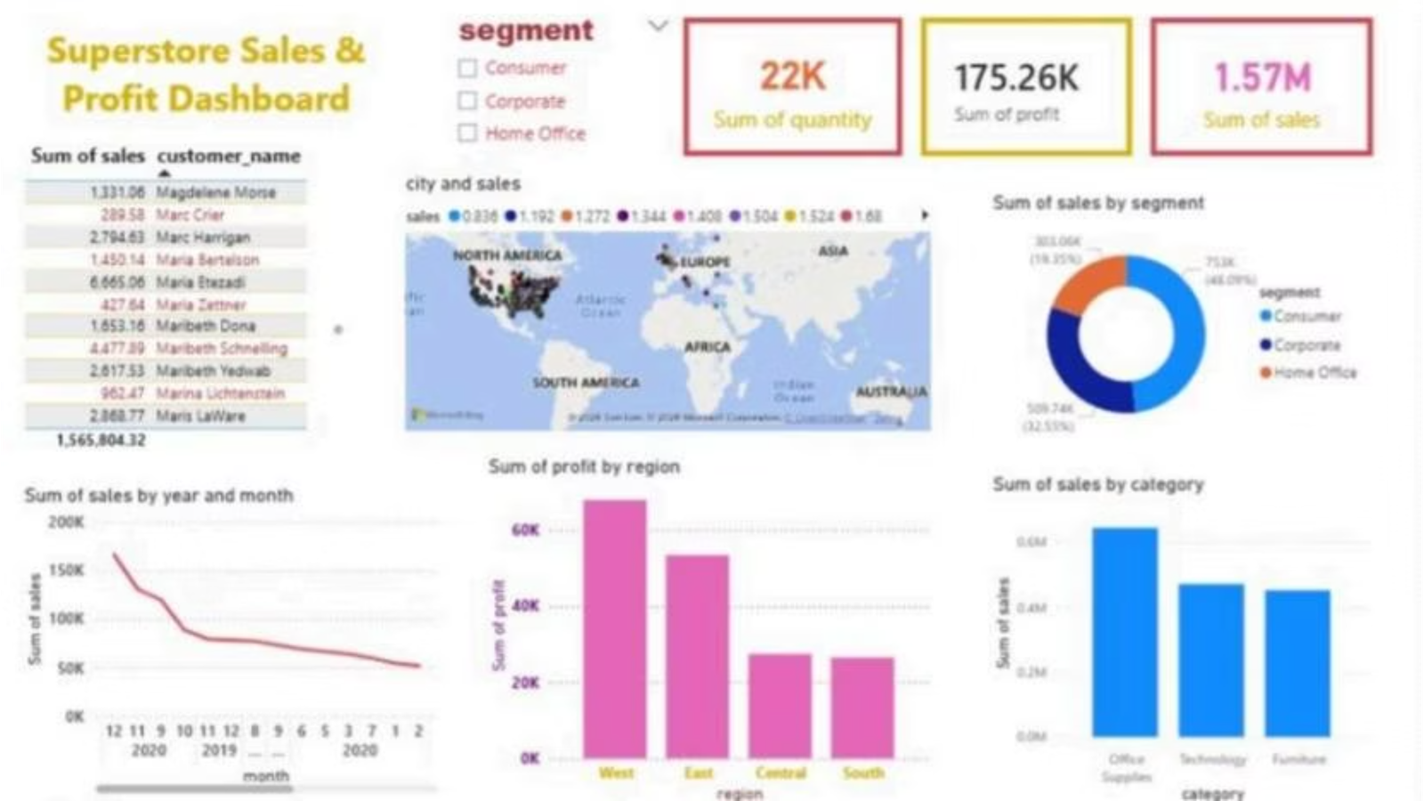

Slide 5
Key Metrics
1.57M
175K
22K
Total Sales
Total Profit
Quantity Sold
Sum of all revenue across the dataset
Positive net earnings with regional variation
Total units across all product categories

Slide 6

Category Performance
Office Supplies Leads
Generates highest revenue among all categories, indicating strong demand and consistent sales patterns.

Slide 7

Regional Performance
West Region
Highest profit contributor, demonstrating strong market performance
East Region
Stable performance with consistent revenue generation
Central & South
Underperforming regions requiring strategic focus and improvement

Slide 8



Customer & Segment Insights
49%
33%
18%
Home Office
Corporate
Consumer
Largest segment share
Growth opportunity
Dominant but limited
A small group of customers contributes a large share of revenue, creating customer concentration risk with heavy reliance on key buyers.

Slide 9




Business Recommendations
Improve Low-Performing Regions
Focus on Central and South regions to boost profitability
Expand Corporate Segment
Leverage growth potential in underdeveloped segments
Strengthen Retention
Reduce customer concentration risk through diversification
Promote High-Performing Products
Capitalize on Office Supplies success across all regions

Slide 10

Conclusion
The analysis highlights key business strengths and weaknesses. By leveraging data-driven strategies, the company can improve profitability, optimize operations, and enhance customer engagement.

